Slide 1
Deep Learning
“Image Caption Generator using Deep Learning Techniques”
Presented By -
Aditya Biswakarma (IIT2020033)
Harshit Kushwah (IIT2020039)
Sanjeet (IIT2020052)
Rohan Tirkey (IIT2020088)
Instructor - Dr. Shiv Ram Dubey, Assistant Professor

Slide 2
Index
Introduction
Literature review
Methodology & Models
Working
Experimental data descriptions
Results
Tools, Language & libraries used for implementation
References

Slide 3
Introduction
To create human-like descriptions of images, the work of image captioning combines computer vision and natural language processing. It has several useful uses, including helping the blind, strengthening search engines, and making digital media more accessible.
Encoding and decoding are the two phases that make up the image's captioning process. From the input image, the encoder extracts significant features, and the decoder uses these elements to create a sentence that explains the image. The capacity of convolutional neural networks (CNNs) to extract high-level information from images makes them a popular choice for encoders in image captioning systems.
The CNN architectures that can be utilised for image captioning are numerous. VGG and ResNet are two popular architectural types. Due to the network's extensive usage of tiny 3x3 convolutional filters, VGG is distinguished by its simplicity. The vanishing gradient problem, which happens when gradients in deep neural networks get too small to be effective for weight updates, is a challenge that ResNet is well known for being able to solve.

Slide 4
Skip connections, which enable gradients to flow straight from earlier layers to later layers and allow for the successful training of much deeper networks, are a feature of the ResNet architecture.
Despite VGG and ResNet's and other computer vision algorithms' successes, it is still necessary to investigate how well they perform when used for image captioning. Other CNN architectures, including Inception, have also been suggested and have demonstrated promising performance in image classification applications. Therefore, it's crucial to evaluate how well various CNN architectures perform when captioning images in order to assess their relative merits and shortcomings. This knowledge will advance the creation of successful image captioning systems and aid in the selection of a suitable model for particular use cases.

Slide 5
Literature review :
We have used 4 research papers for our reference -
The Complete LR can be accessed with the following link -
https://docs.google.com/document/d/1CmVlJgLIJ784DRI9IAeEKAwJ8lu_zu6r9YuiPZ8pLl4/edit?usp=sharing

Slide 6
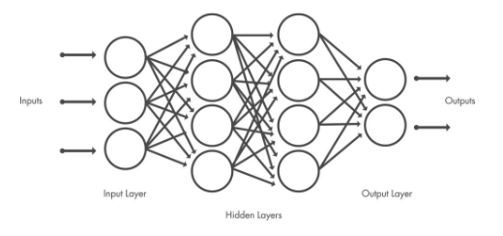
Methodology & Models
Convolutional Neural Network (CNN)- A Convolutional Neural Network (ConvNet/CNN) is a Deep Learning algorithm that can take in an input image, assign importance (learnable weights and biases) to various aspects/objects in the image, and be able to differentiate one from the other. The pre-processing required in a ConvNet is much lower as compared to other classification algorithms. While in primitive methods filters are hand-engineered, with enough training, ConvNets have the ability to learn these filters/characteristics.
Like other neural networks, a CNN is composed of an input layer, an output layer, and many hidden layers in between.

Slide 7
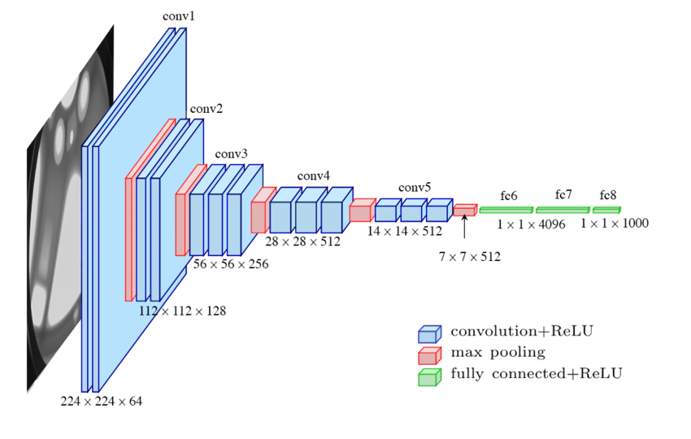
VGG16 -
The Visual Geometry Group (VGG) at the University of Oxford developed the convolutional neural network (CNN) model known as the VGG16 architecture in 2014. The architecture consists of 16 layers, including 3 fully connected layers and 13 convolutional layers. ReLU activation functions and max pooling layers come after the convolutional layers, which employ modest 3x3 filters with a stride and padding of 1. Each of the fully connected layers has 4096 units, and the 1000 units of the softmax output layer—which corresponds to the 1000 classes in the ImageNet dataset—comes after them. The design of VGG16, which is renowned for being both straightforward and elegant, has frequently served as a baseline for a variety of computer vision tasks, such as image classification, object detection, and image captioning.

Slide 8
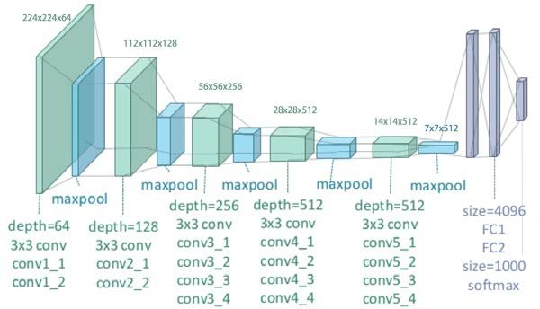
VGG19 -
The 19-layer VGG19 convolutional neural network architecture is a development on the VGG16 design. A sequence of convolutional layers are followed by a max pooling layer in VGG19, much like in VGG16. The network has three fully connected levels at its conclusion. The input feature map's spatial dimensions are preserved via the 3x3 filter size and padding used by all of the convolutional layers in VGG19. The fact that VGG19 has more convolutional layers than VGG16, which means there are more parameters to learn, is one of their primary differences. Due to its improved ability to understand complex features from images, VGG19 is now more computationally expensive to train. Additionally, batch normalisation is utilised by VGG19, which accelerates training speed and stability.

Slide 9
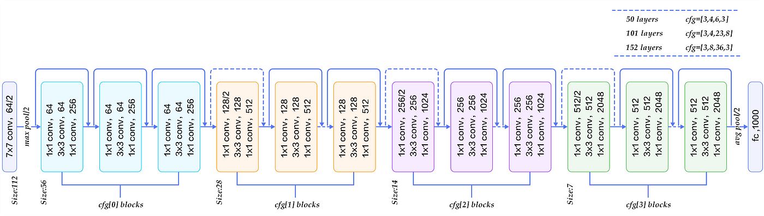
ResNet50 -
A deep residual neural network with 50 layers is called ResNet50 (Residual Network 50). It is well recognised for its skip connections or "identity shortcuts" that aid in teaching the network residual layer-to-layer mapping. As a result, the network may acquire richer, more detailed representations of images, improving its accuracy in image recognition tasks. The bottleneck layers in ResNet50's modular architecture serve to lower the network's computational complexity. Three convolutional layers with batch normalisation and a skip connection are included in each block of the ResNet50 architecture. Overall, ResNet50's architecture is created to maximise computing efficiency while enhancing deep neural network performance on image classification tasks.

Slide 10
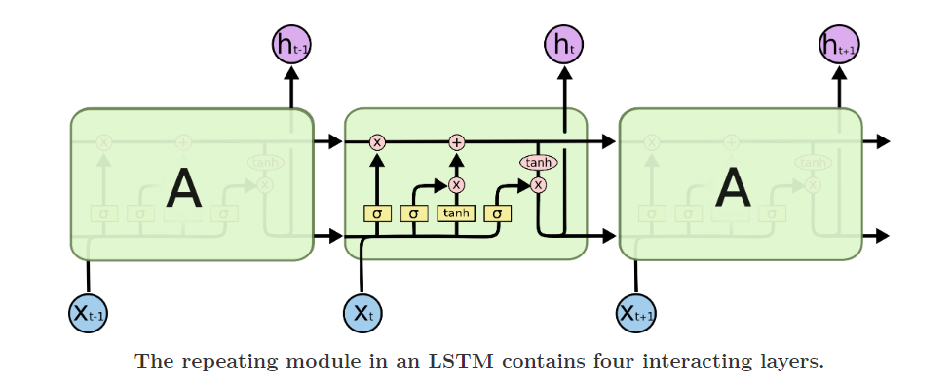
Text Generation using LSTM
A common LSTM unit is composed of a cell, an input gate, an output gate and a forget gate. The cell remembers values over arbitrary time intervals and the three gates regulate the flow of information into and out of the cell.
The advantage of an LSTM cell compared to a common recurrent unit is its cell memory unit. The cell vector has the ability to encapsulate the notion of forgetting part of its previously-stored memory, as well as to add part of the new information. To illustrate this, one has to inspect the equations of the cell and the way it processes sequences under the hood.

Slide 11
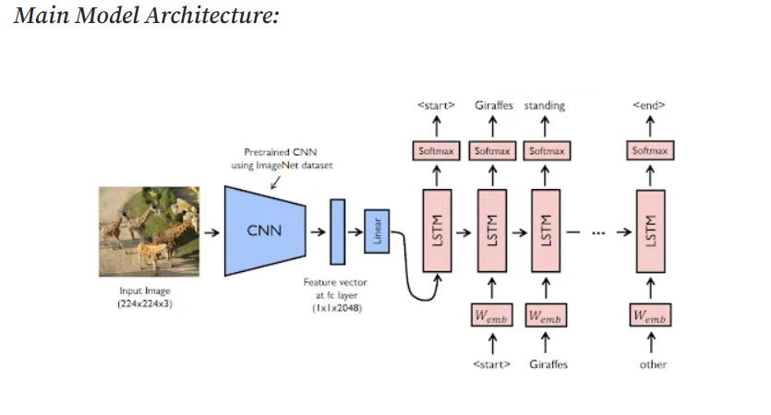
Model
This final model is a combination of CNN and RNN models.

Slide 12
Working
In order to extract the features from the input image, the model's general architecture employs a pretrained CNN (such as VGG16, VGG19, ResNet50, etc.). The feature vector's dimension is decreased by passing the features via a fully connected layer. The LSTM network then receives this feature vector as input and produces a sequence of words that serve as the image's caption.
The model is fed pairs of photos along with their accompanying captions during training. The CNN is used to extract the features from the images, and these features—along with the captions—are provided as input to the LSTM network. The predicted caption for the image is created by the LSTM network by producing a sequence of words.
The weights of the model are changed to reduce a difference between the predicted and real captions after comparing the predicted and actual captions. The training is typically done using backpropagation through time (BPTT) algorithm.

Slide 13
The pretrained CNN is used by the model to extract features from an input image during testing. To create the feature vector, which serves as the input for the LSTM network, these features are transferred through the fully connected layer. The caption for the input image is created by the LSTM network through a sequence of words.
The accuracy of the model is assessed using the BLEU (Bilingual Evaluation Understudy) score. A statistic called BLEU assesses how closely the expected and real captions resemble each other. It might be anywhere between 0 and 1, with 1 denoting a perfect match between the expected and actual captions.
In summary, the image caption generator using CNN (pretrained) + LSTM trained on Flickr8k dataset involves using a pretrained CNN to extract features from images, feeding these features to an LSTM network along with the captions during training, and generating a sequence of words that form the caption for the input image during testing. The BLEU score is used to evaluate the performance of the model.
.

Slide 14
Experimental data descriptions
We have taken the dataset for this model from
https://www.kaggle.com/datasets/adityajn105/flickr8k
https://image-net.org/download.php
A new benchmark collection for sentence-based image description and search, consisting of about 8,000 images that are each paired with five different captions which provide clear descriptions of the salient entities and events. The images were chosen from six different Flickr groups, and tend not to contain any well-known people or locations, but were manually selected to depict a variety of scenes and situations.

Slide 15
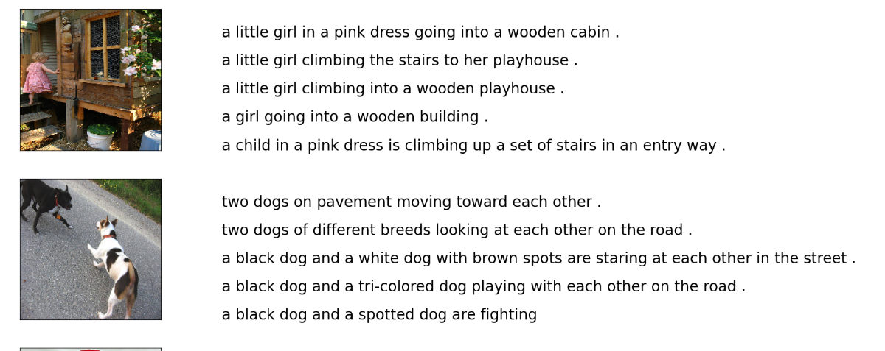
Experimental data

Slide 16
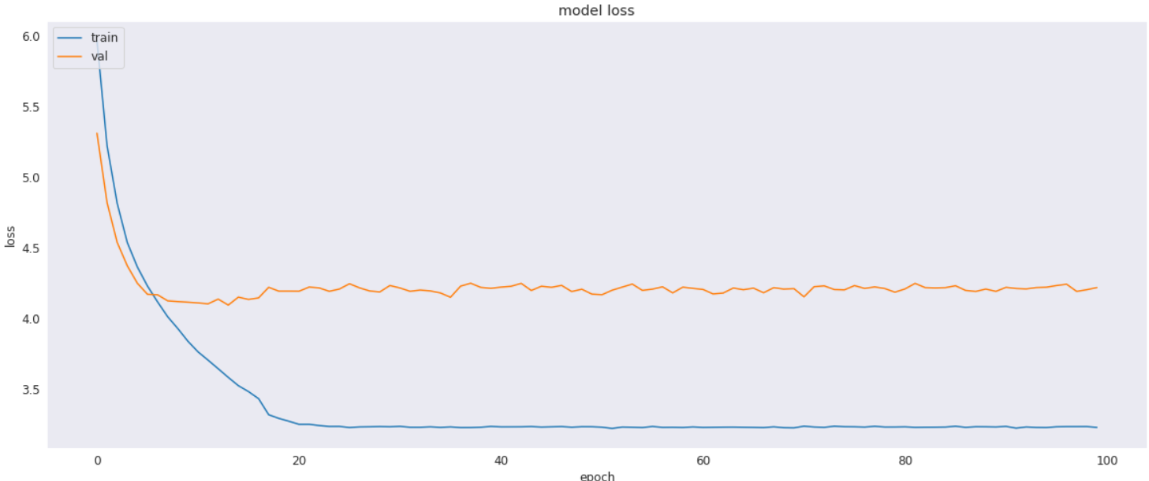
Learning Curves
For VGG-16:

Slide 17
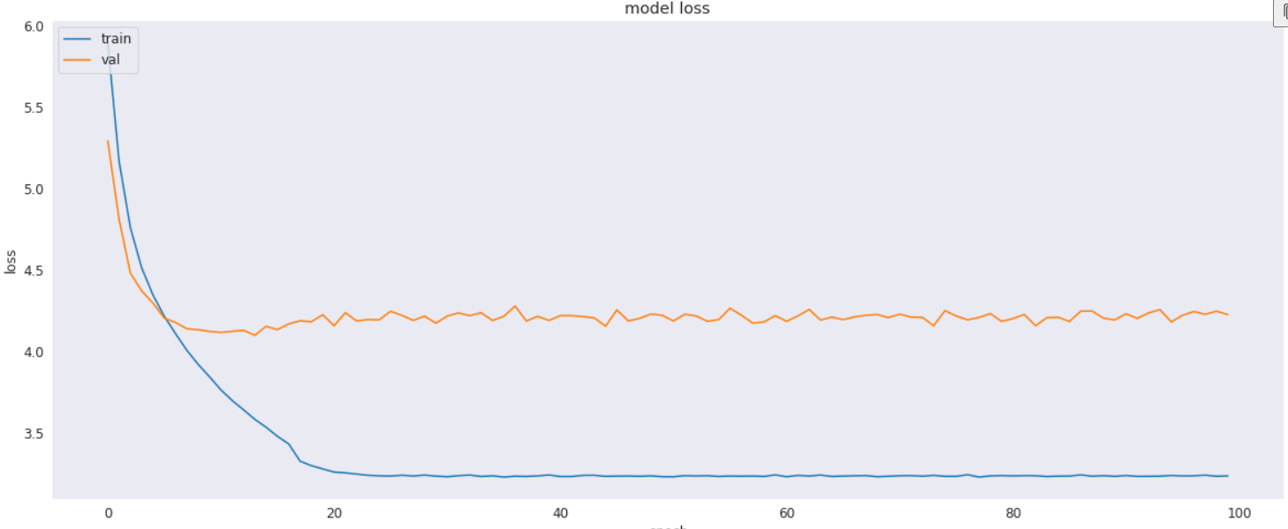
Learning Curves
For VGG-19:

Slide 18
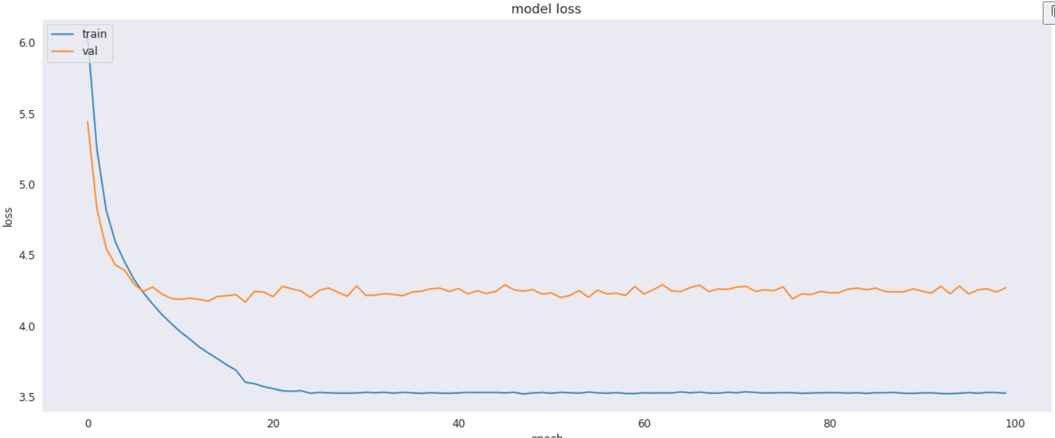
Learning Curves
For ResNet-50:

Slide 19
Results: Mean BLEU Score
The BLEU score of the the model with different CNN models are:
VGG-16: 0.2202568481652174(Min), 0.8931539818068694(Max), 0.57(Mean)
VGG-19: 0.1887535121456652(Min), 0.8931539818068694(Max), 0.57(Mean)
ResNet50: 0.19694347419590436(Min),0.8931539818068694(Max), 0.61(Mean)

Slide 20
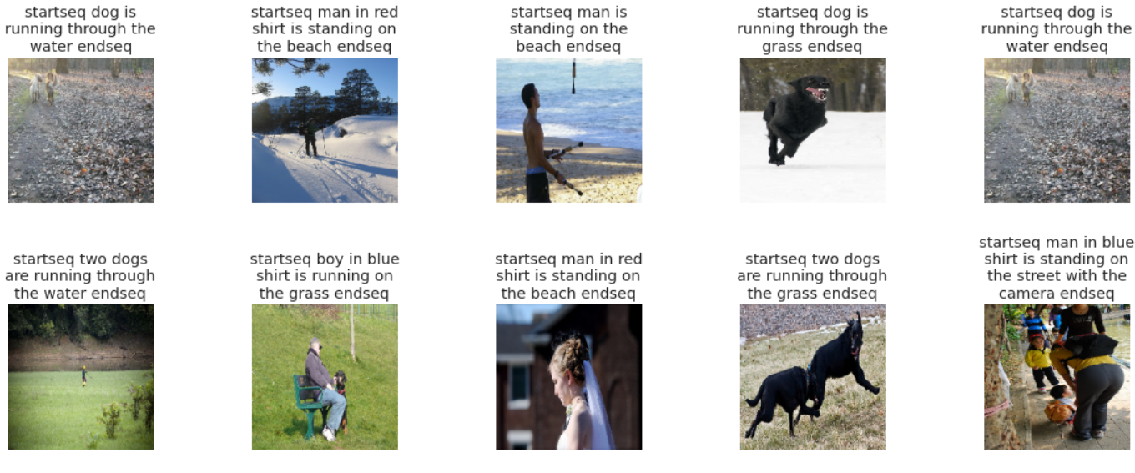
Sample Outputs
The captions generated by the three model for same pictures are shown:
VGG-16

Slide 21
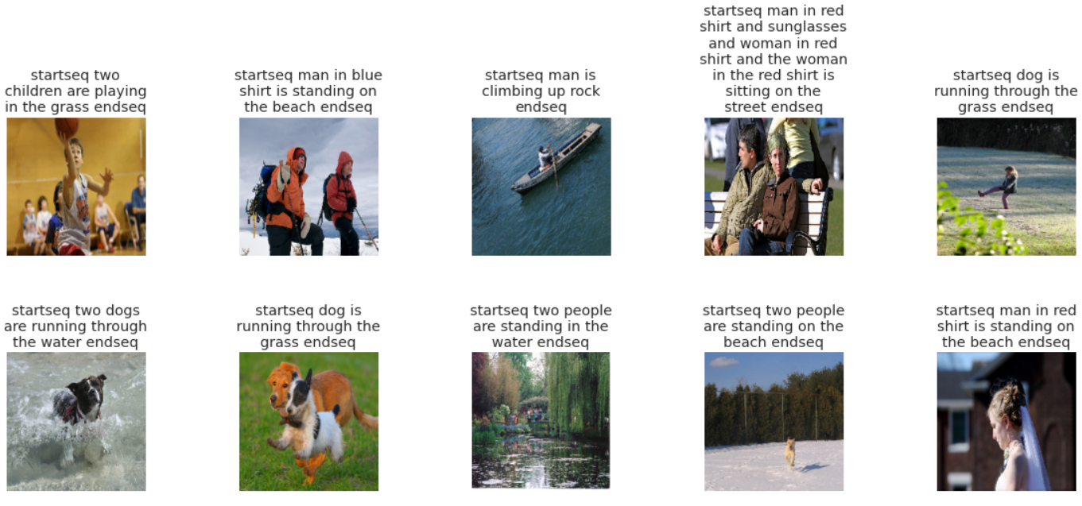
VGG-19:

Slide 22
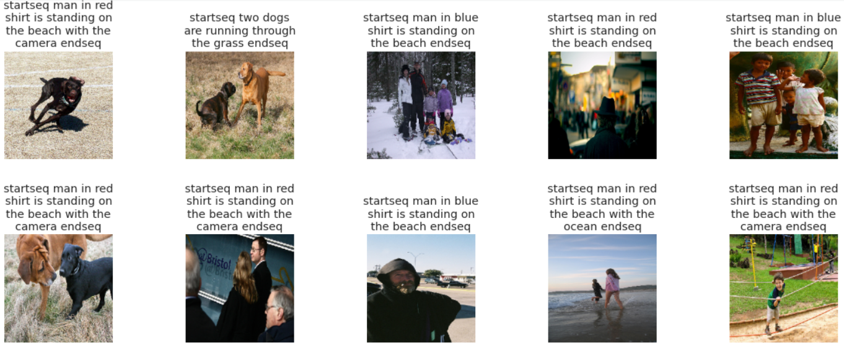
ResNet-50

Slide 23
Limitations
The models were trained on a small dataset.

Slide 24
Tools, Language & libraries used for implementation
Software Technologies Required -
Python (latest version)
Or Google Colab Or Jupyter Notebook for running ipynb file
Kaggle
Other important libraries required will be -
Keras
Pandas
Numpy
Matplotlib
nltk
Hardware Requirements
Graphics Card / GPU (if possible) (Google Colab will perform better)

Slide 25
References :
Aneja, Jyoti, Aditya Deshpande, and Alexander G. Schwing. "Convolutional image captioning." Proceedings of the IEEE conference on computer vision and pattern recognition. 2018.
Cornia, Marcella, et al. "Meshed-memory transformer for image captioning." Proceedings of the IEEE/CVF conference on computer vision and pattern recognition. 2020.·

Slide 26
THANKS!

